Slide 1
Network Simplex Method

Slide 2
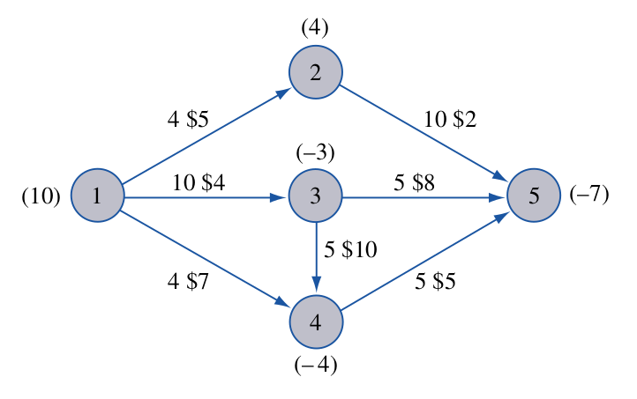
Minimum-Cost Network Flow Problems
The following problems are all special cases of the minimum-cost network flow problem (MCNFP):
Transportation
Assignment
Transshipment
Shortest-path
Maximum flow
CPM problems
Any MCNFP can be solved by a generalization of the transportation simplex called the network simplex.

Slide 3
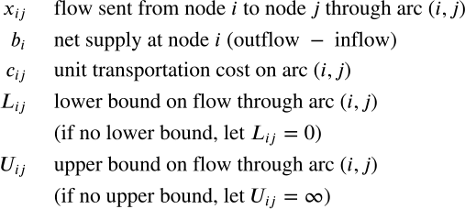
Minimum-Cost Network Flow Problem formulation

Slide 4
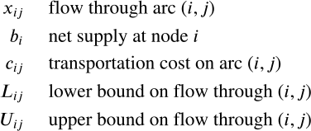
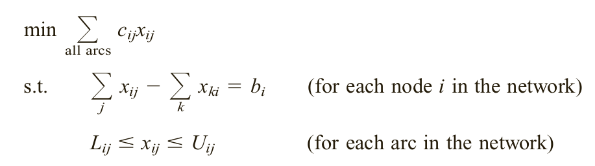
Minimum-Cost Network Flow Problem formulation

Slide 5
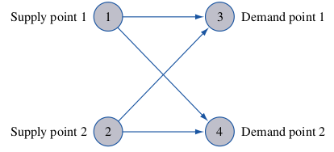
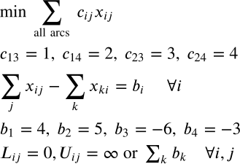
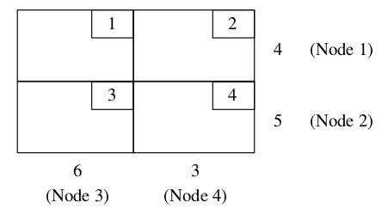
Formulate a Transportation Problem as an MCNFP

Slide 6
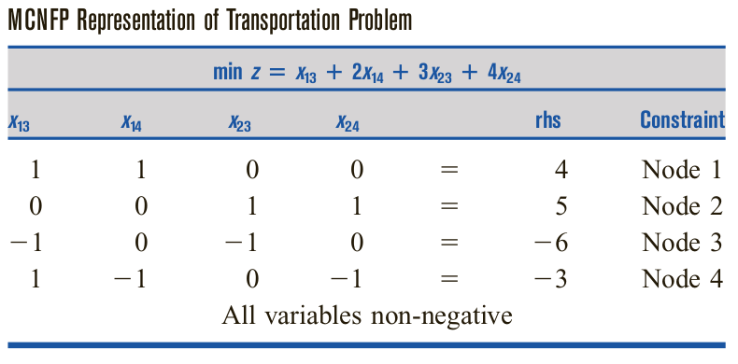
Formulate a Transportation Problem as an MCNFP
0
This is clearly a TUM!!!

Slide 7



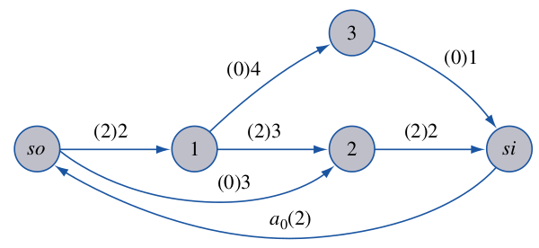

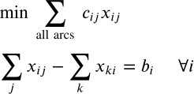
Formulate a Maximum-Flow Problem as an MCNFP
Consider the Max Flow Problem from source to sink.
Include arc . What is now?
What is here?
How to set for the arcs?

Slide 8
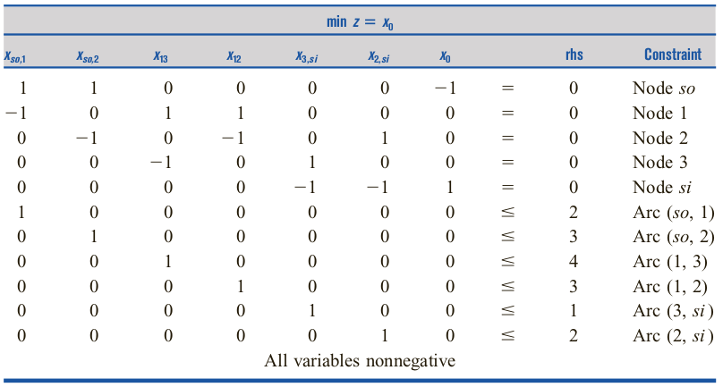
Formulate a Maximum-Flow Problem as an MCNFP

Slide 9
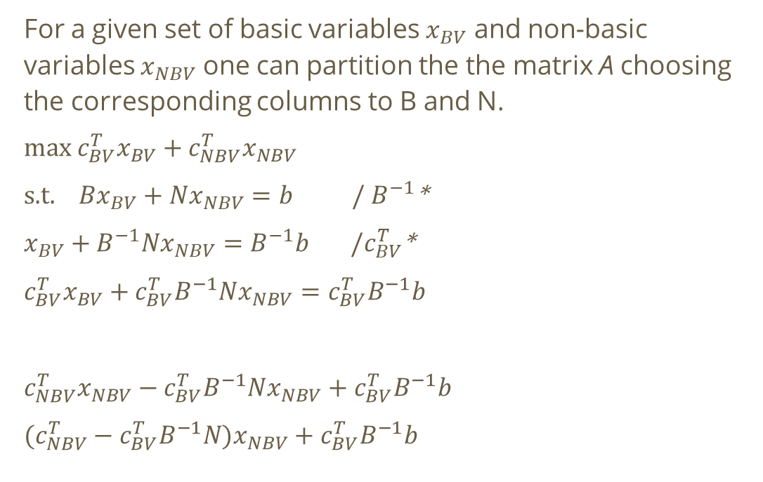
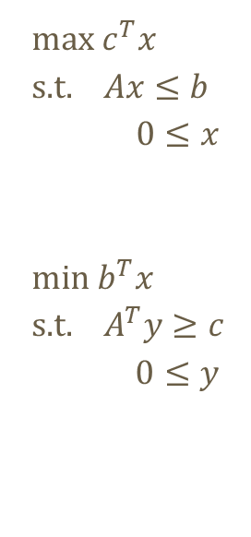
Standard primal and dual pair in the simplex method

Slide 10
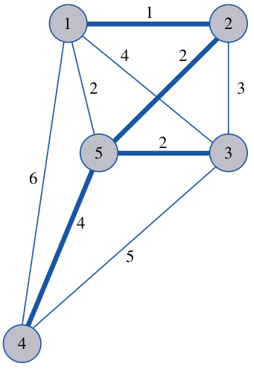
Minimum Spanning Tree Problems
For a network with n nodes, a spanning tree is a group of n-1 arcs that connects all nodes of the network and contains no loops.
A spanning tree of minimum length in a network is a minimum spanning tree (MST).
MST can be found by a greedy algorithm including always the shortest edge which makes no loop in the result.

Slide 11
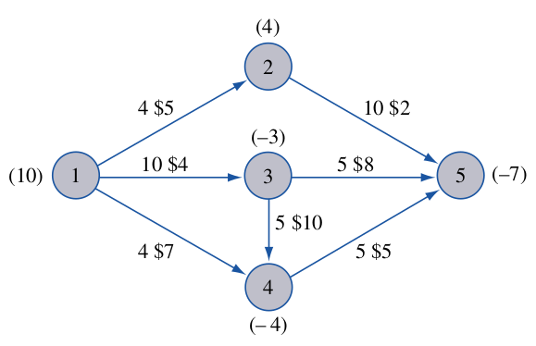
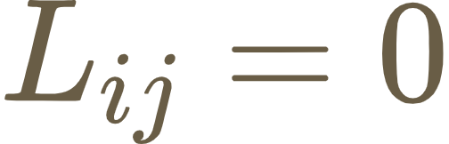






The Network Simplex Method
It is how the simplex algorithm simplifies for MCNFPs.
For simpliness: for each arcs.
In (.) -s are given, while the
$ note the -s.
are on arcs.
For Network Simplex
method to work,
must hold.

Slide 12



Basic Feasible Solutions for MCNFPs
Basic variables:
In the absence of degeneracy, each basic variable satisfies
with degeneracy, it is possible for a basic variable to equal arc (i, j)’s upper or lower bound.
Nonbasic variables: equal the arc’s lower or upper bound, i.e.

Slide 13

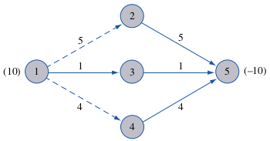
Basic Feasible Solutions for MCNFPs
If fulfills, conservation-of-flow constraints will automatically satisfy the last constraint, so we can drop one constraint.
That gives basic variables. basic var.
Any such set of basic variables are feasible iff they span a tree. non-basic v.

Slide 14
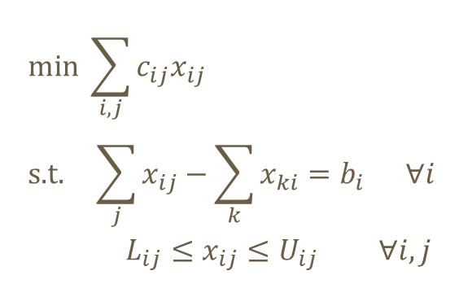
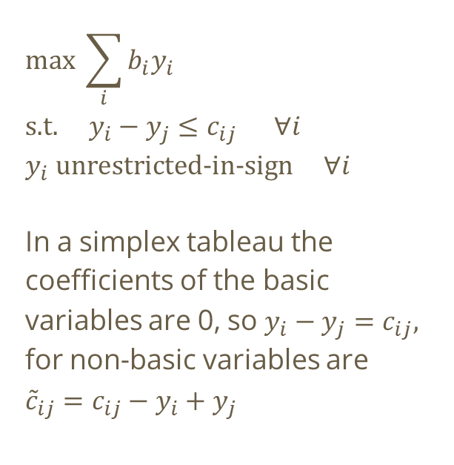
For optimality: MCNFP and its dual problem
0

Slide 15
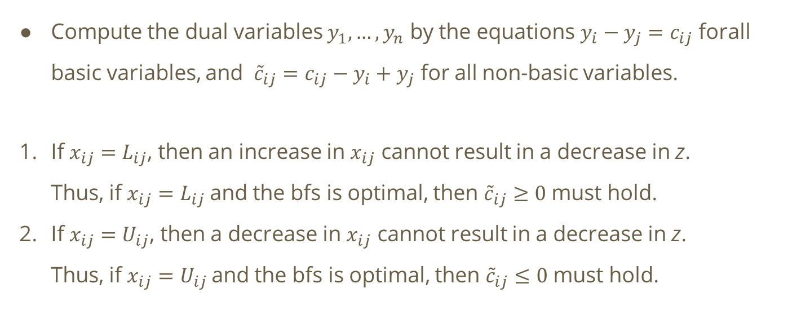
Optimality of a basic feasible solution

Slide 16
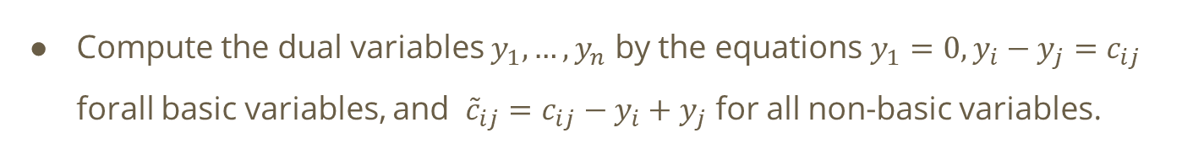
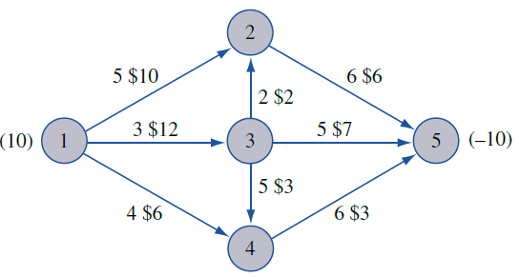
Optimality of a basic feasible solution

Slide 17
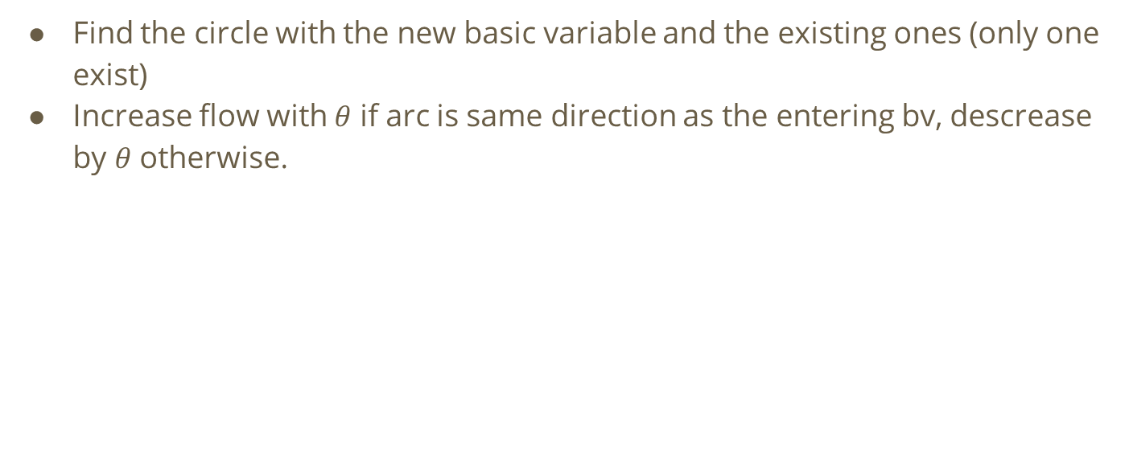
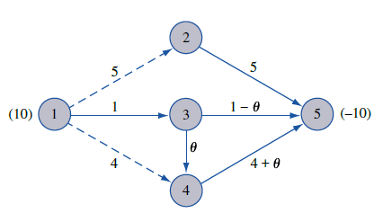
Pivoting in the Network Simplex method

Slide 18
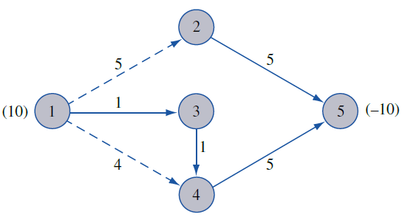
Optimal?

Slide 19
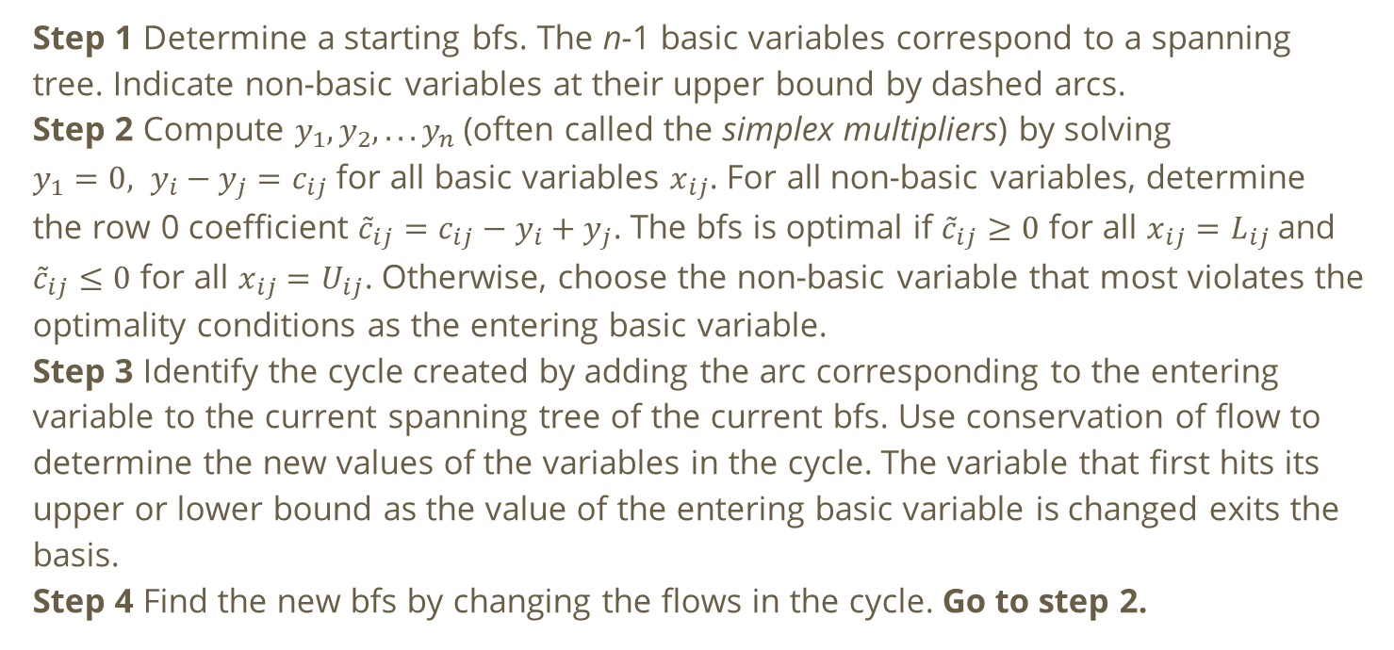
Network Simplex method summary

Slide 20
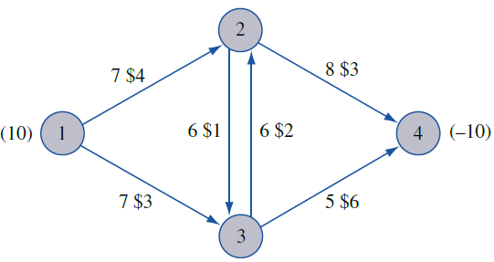
Example

Slide 21
Example

Slide 22
Example

